Slide 1
West Manor ES
Mays Cluster
Dr. Reginald Lawrence

Slide 2
12 years
0
14 years
0
[IB]
Authorized
***
October 2026
Student Support 5: Community Engagement and Approaches to Teaching 2: Conceptual Understanding to support ideas
30 students
242
12 students
218
22 & 9 second looks
24

Slide 3
Indicator | Time Frame
 | September 2021 | September 2022
Attendance Take Rate | 100% | 100%
ADA Attendance Rate | 91.9% | 92.4%
Students not chronically absent | 76% | 82.7%
0.13
Subgroup | Total number of students | OSS Suspension Rate
Female | 122 | 0
Male | 121 | 0.27
SWD | 19 | 0
Black | 199 | 0.16
Hispanic | 36 | 0
Multi-race | N/A | N/A
White | N/A | N/A
Asian | N/A | N/A
*As of 10/02/2022
*As of 9/28/2022
Notes:
ACES 2.0 School culture
Restorative practices
Family engagement

Slide 5
Program | Avg. Daily Use (Mins) |  | Avg. Weekly Use (Days)
 | Spring 2022* | Fall 2022** | Spring 2022 | Fall 2022
System 44 | 23.7 minutes | 17.2 minutes | 2.4 days | 2.4 days
iRead | 32.7 minutes | 27.1 minutes | 2.1 days | 1.7 days
*Spring 2022: As of April 30, 2022
**Fall 2022: As of September 16th, 2022

Slide 6
 | CIP Strategy | Action Step Progress Update
ELA | Implementation of intervention block from 9am to 9:45 4 times a week | –shown on Master Schedule, Occurs daily –Walkthrough completed by Cluster Colleagues (Learning Walk) –Added 2 teachers in every homeroom to assist with small group instruction
Math | Employ a PLC process that requires teachers to model lessons and present what students are to know and do in order to reach a level of mastery regarding the standard | –Show in Master Schedule (MTW) –Teacher presentations as artifacts of implementation -Exit tickets used for data points
Whole Child & Student Support | Creation of Attendance/ Care Team to identify and address needs of students | Teams meeting with sign ins and minutes Conducted first attendance celebration Highest attendance in cluster for August
Family Engagement | Conduct Parent meetings on Data and trainings on how to support students 3 times a year | conducted Family Engagement Event 9/2 Cascade Skate Rink 9/13 Conducted Data Night

Slide 8
Consistent Support Schedule (who is assigned to my school and on what days)
Family engagement grant funds released
Leveling Funding added to my budget

Slide 10
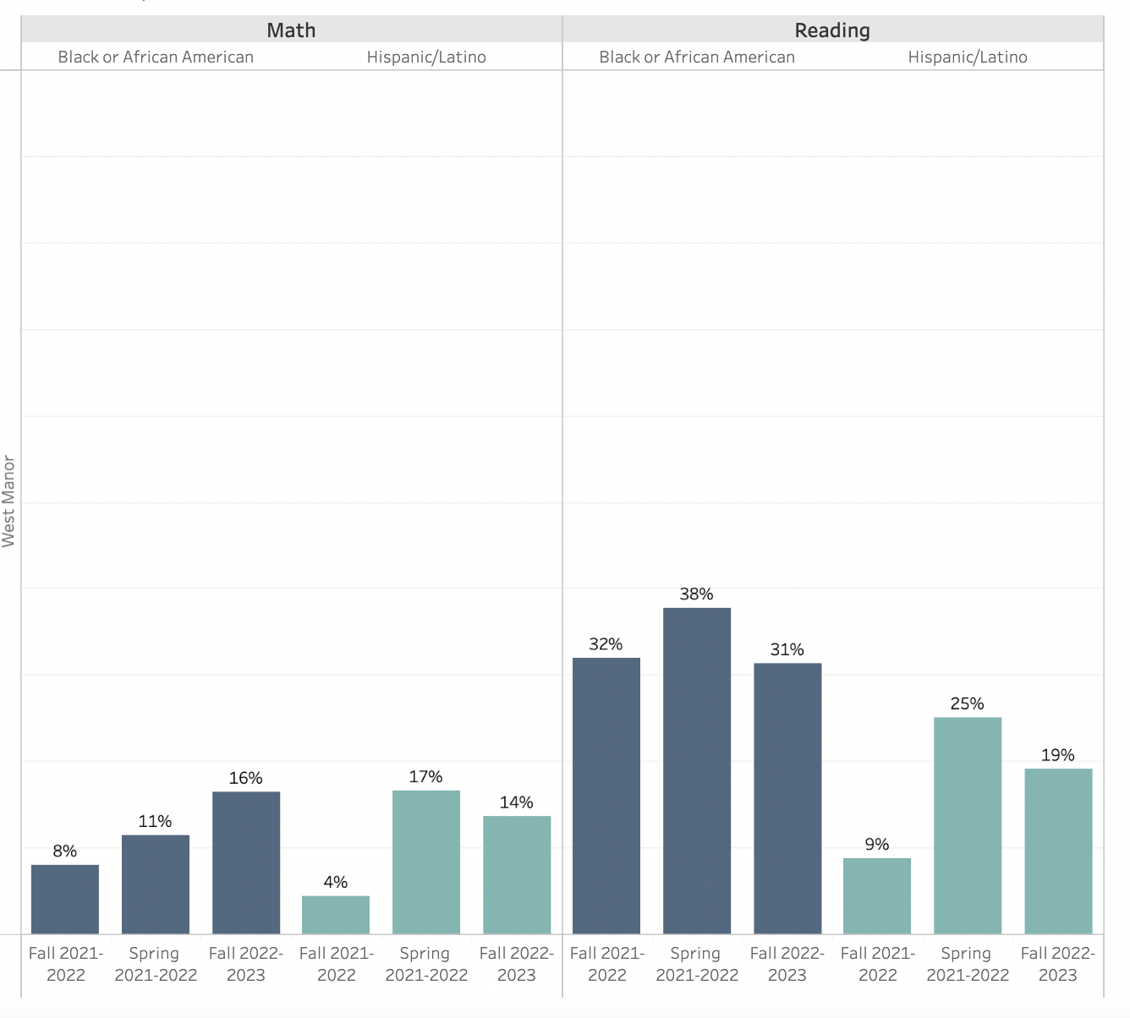

Slide 11
